Slide 1
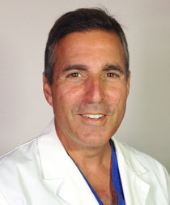
Surgical Management of Lung Cancer
Ara S. Klijian, MD Director, Minimally Invasive Cardiovascular & Thoracic Surgical Institute
Chairman, Cardiothoracic Surgery, Sharp
Attending Surgeon, Sharp & Scripps Hospitals, San Diego, USA

Slide 2
Disclosures
Consultant for B-D (Lung Sealants)
Consultant for La Jolla Pharmaceutical (Vasoplegia Management)
Consultant for Eagle (Management of PONV)

Slide 3
Objectives
Understand the Surgical Resection Options for Lung Cancer
Understand when Segmental Resection is Applicable
Understand the role of AVATS (Awake Video Assisted Thoracic Surgery) for treatment of lung cancer

Slide 4
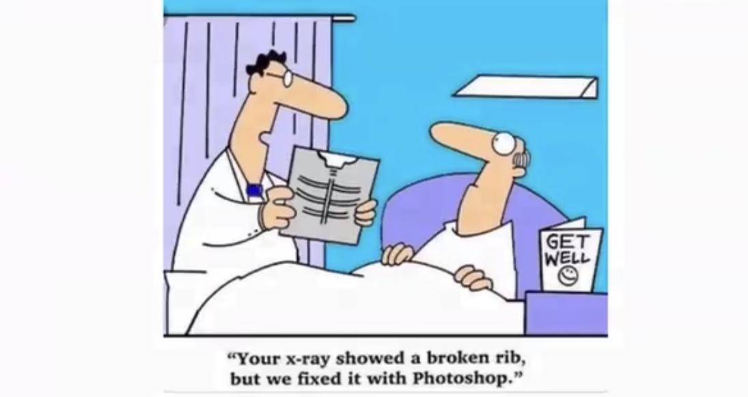

Slide 5
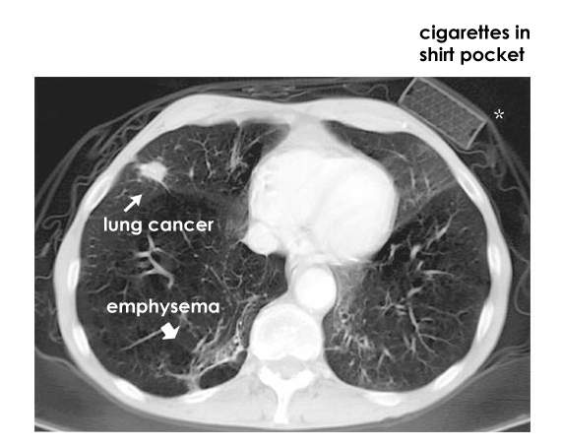

Slide 10
Types of MITS
Video-assisted thoracic surgery (VATS)
Natural orifices translumenal endoscopic surgery (NOTES) (i.e. TransEsophageal Zenker’s Diverticulectomy)
Muscle-sparing microthoracotomy
Image-guided, needle-based diagnosis and treatments

Slide 11
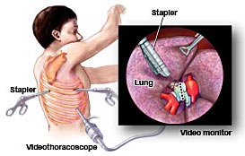

Slide 12
Benefits of Minimally Invasive Thoracic Surgery
Smaller Incisions
Less postop pain and faster recovery
Shorter Hospital Stays
Less Intraoperative Bleeding
Limits skin and muscle devision

Slide 13
Benefits
Magnified view with high resolution
Reduced inflammation
No need to cut or spread ribs/less pain
Shorter chest tube duration
Less negative impact on postoperative pulmonary function
Faster onset of chemotherapy/RT

Slide 14
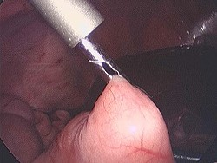

Slide 15
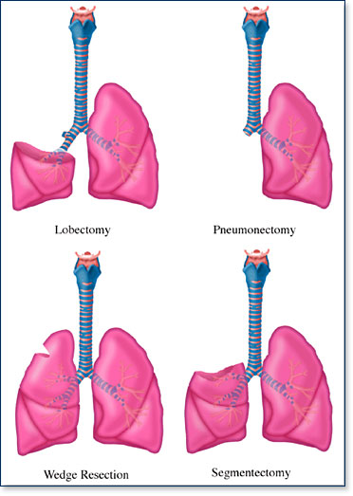
Extent of operation

Slide 21
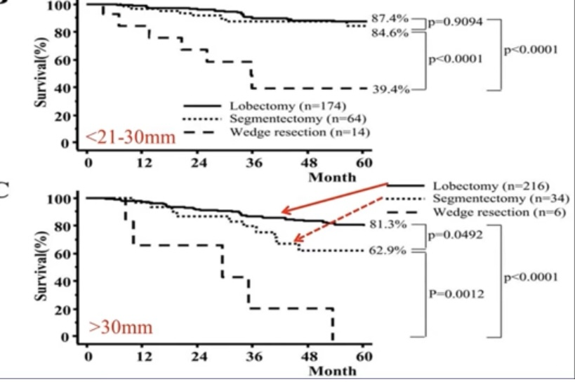

Slide 22
REASONS FOR LIMITED RXN
EARLIER/SMALLER LESIONS
Save lung fxn for 2nd lesion
Poor FEV1
Poor functional status of patient
Able to do via VATS ( less M/M)

Slide 23
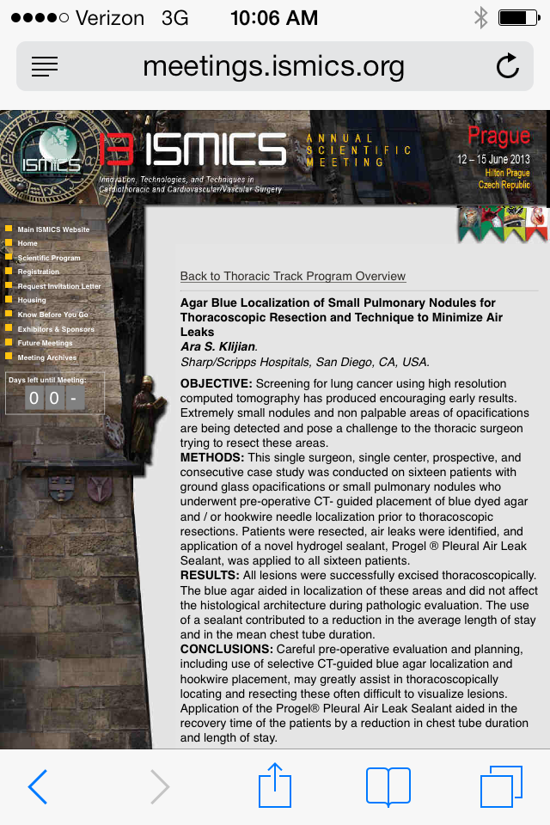
Klijian, A. “Agar Blue Localization of Small Pulmonary Nodules for Thoracoscopic Resection and Technique to Minimize Air Leaks”,
Innovation, Technologies and Techniques in Cardiothoracic and Cardiovascular/Vascular Surgery Annual Scientific Meeting, Prague, Jun 2013.

Slide 24
16 Agar Blue Localization
4 Complex GGO’s > 2 cm.
12 Sub-solid nodules < 1.5 cm.
Klijian, A. “Agar Blue Localization of Small Pulmonary Nodules for Thoracoscopic Resection and Technique to Minimize Air Leaks”,
Innovation, Technologies and Techniques in Cardiothoracic and Cardiovascular/Vascular Surgery Annual Scientific Meeting, Prague, Jun 2013.

Slide 25
Technique
Liquified Agar
Methylene Blue Dye
Kopan’s Hook wire
CT Guided
Klijian, A. “Agar Blue Localization of Small Pulmonary Nodules for Thoracoscopic Resection and Technique to Minimize Air Leaks”,
Innovation, Technologies and Techniques in Cardiothoracic and Cardiovascular/Vascular Surgery Annual Scientific Meeting, Prague, Jun 2013.

Slide 26
Agar Blue
Klijian, A. “Agar Blue Localization of Small Pulmonary Nodules for Thoracoscopic Resection and Technique to Minimize Air Leaks”,
Innovation, Technologies and Techniques in Cardiothoracic and Cardiovascular/Vascular Surgery Annual Scientific Meeting, Prague, Jun 2013.

Slide 27
Agar Blue
Klijian, A. “Agar Blue Localization of Small Pulmonary Nodules for Thoracoscopic Resection and Technique to Minimize Air Leaks”,
Innovation, Technologies and Techniques in Cardiothoracic and Cardiovascular/Vascular Surgery Annual Scientific Meeting, Prague, Jun 2013.

Slide 29
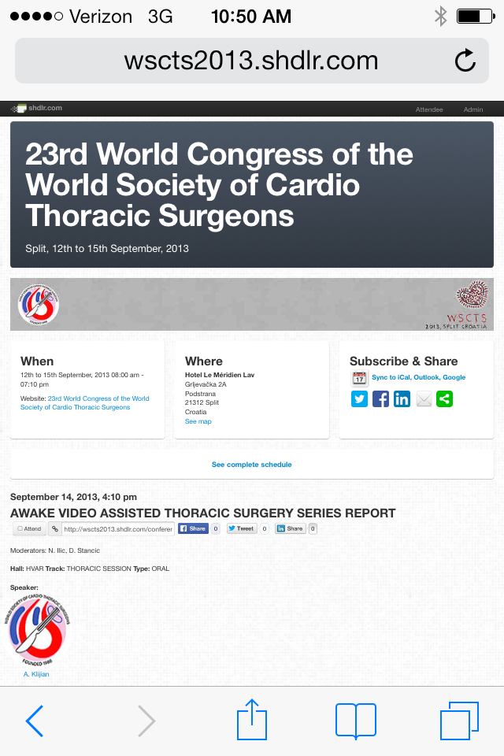

Slide 30
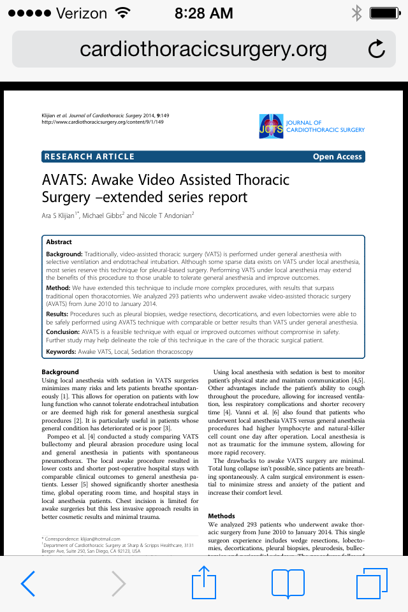

Slide 31
AVATS : A Technique Born of Necessity, Maintained on Merit
Patient 1: 56 y.o. male with 3 cm. peripheral lung CA, FEV1 of 0.58, CT scan showed no mediastinal adenopathy/metastatic disease, deemed inoperable from general anesthetic risk, failed Chemo/R.T./Cyberknife
Awake VATS with wide wedge resection, margins negative, discharged home on POD 2
Five year follow-up, disease free
Klijian, A. “AVATS: Awake Video Assisted Thoracic Surgery in Complex Thoracic Procedures.” Clinics in Surgery, Vol 1, 14 May 2016.

Slide 33
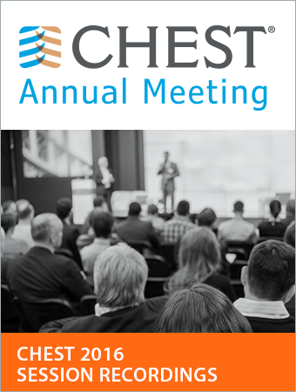
AVATS
512 AVATS cases from June 2010 – Sept 2016
18 – 90 years of age, average age 66
271 males/ 241 females

Slide 34
Comorbidities
224 DM
136 COPD
68 Atrial Fibrillation
228 HTN
129 CAD (61 w/ previous MI)
12 Chronic hepatic failure
46 Chronic renal failure (38 Dialysis)
203/246 pts. who had lung rxn had FEV1<0.8
(1 patient w/ FEV1 = 0.58)
Klijian, A. “Awake Video-Assited Thoracic Surgery (AVATS): Performing Complex Thoracic Surgical Procedures Without General Anesthesia.” CHEST, Vol 150, Issue 4, 30A

Slide 35
Case # LOS (days)
Wedge Rxn 134 1.3
Lobectomies 84 1.6
Decortication 108(16w/wedge) 2.1
Pleural Bx 56 1
Pleurodesis 104 1.2
Pericardial Window 8 1.1
Bullectomy 12 1.5
BPF repair 2(1w/wedge) 2
Repair Perf Esoph 2 6
Diapragm repair 1 1
Chyle leak repair 1 2
Klijian, A. “Awake Video-Assited Thoracic Surgery (AVATS): Performing Complex Thoracic Surgical Procedures Without General Anesthesia.” CHEST, Vol 150, Issue 4, 30A

Slide 36
Operative Technique
48 CVP used (no Swan-Ganz)
92 Arterial lines(71/84 lobes & 21/108 decort)
40 Foleys used (all removed w/in 6 hrs of OR)
Dexmedetomidine/versed
Modified Supine positioning
Klijian, A. “Awake Video-Assited Thoracic Surgery (AVATS): Performing Complex Thoracic Surgical Procedures Without General Anesthesia.” CHEST, Vol 150, Issue 4, 30A

Slide 37
Results
Of the 512 total cases, 82 required one day stay in ICU, all others went to telemetry unit following PACU
All patients satisfactorily treated with oral pain meds (tylenol w/codiene) after 1-2 doses of IV morphine
138 patients received IV or oral Toradol
38 patients received IV Aceteminophen
98% patients with comfort index of < 2 (0=no pain, 10=extreme pain)
2% comfort index = 3-4
Klijian, A. “Awake Video-Assited Thoracic Surgery (AVATS): Performing Complex Thoracic Surgical Procedures Without General Anesthesia.” CHEST, Vol 150, Issue 4, 30A

Slide 38
Results
No deaths
No conversion to general/intubation
30 pts w/ complication of AF overall (22 AF in lobes, 8 AF in decortications)
1 IV site phlebitis
No strokes, acute or delayed PTx, DVT/PE,
UTI, Pneumonia, 6 month re-admissions

Slide 42
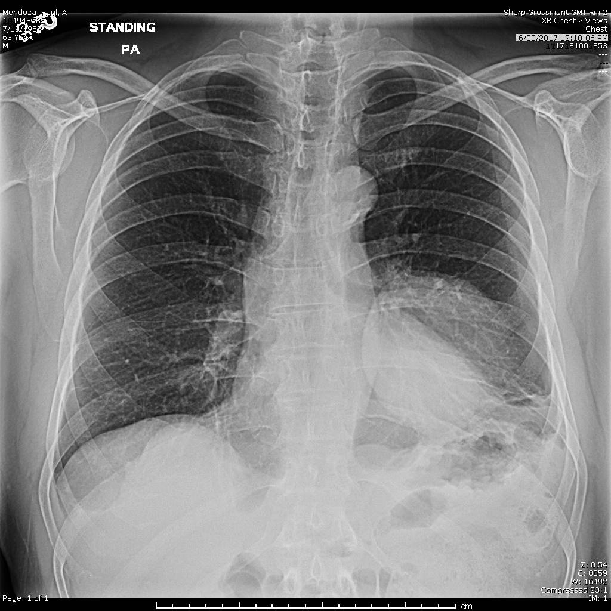
6/30/2017

Slide 43
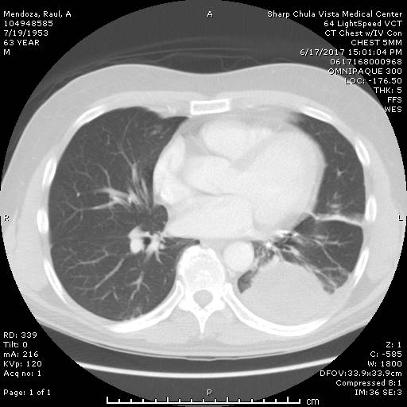
6/17/2017

Slide 44
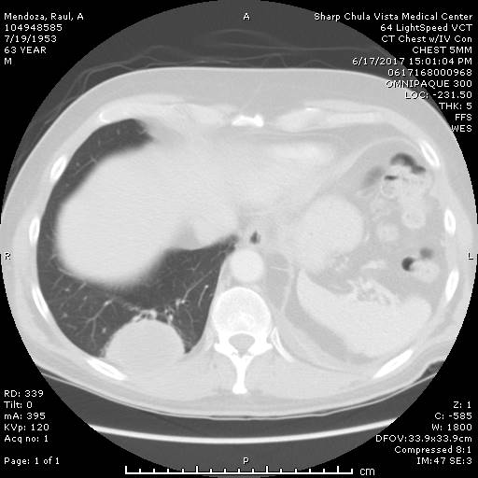

Slide 45
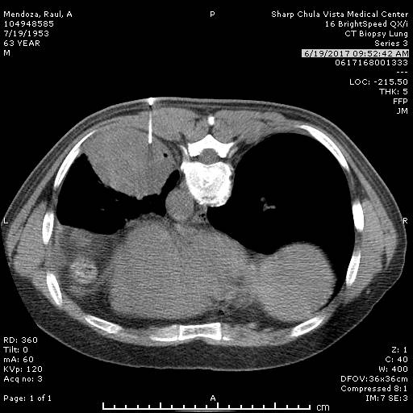

Slide 46
7/3/2017
Patient underwent a right AVATS/thoracoscopy with resection of mass and abutting chest wall/diaphragm.
Patient was discharged home on 7/5/2017 on postop day #2.

Slide 47
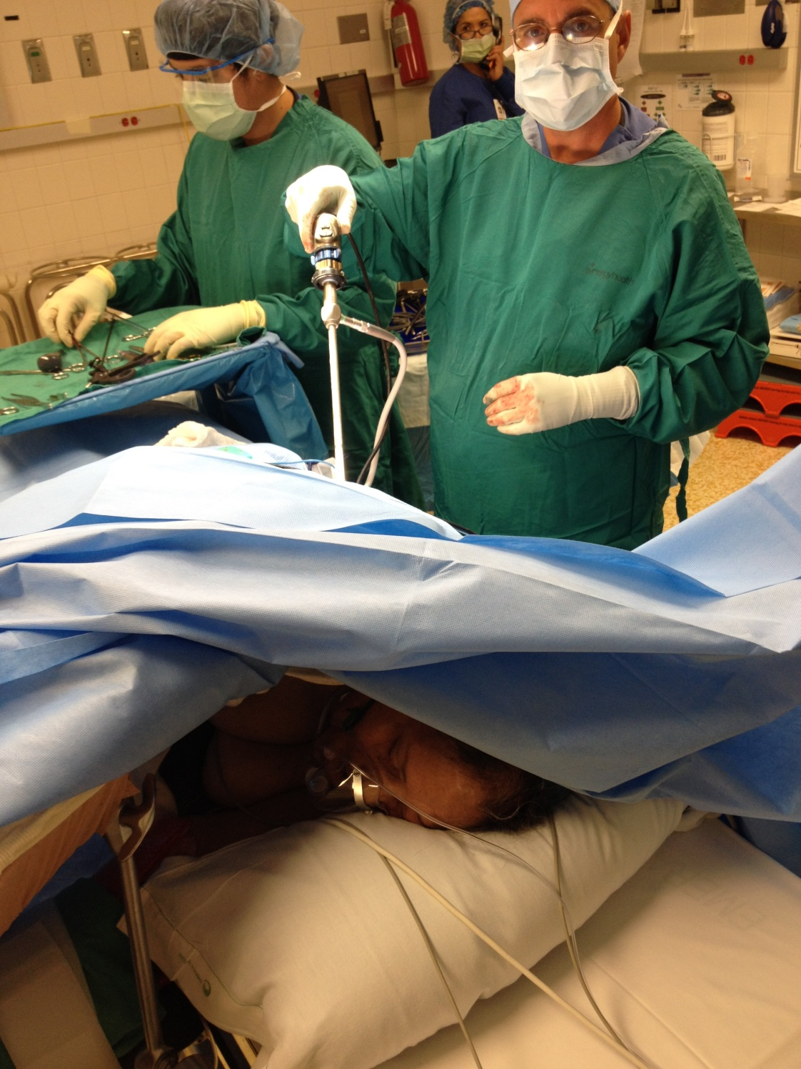

Slide 48
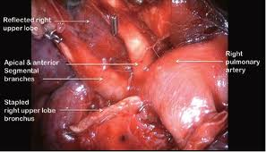
Reflected right upper lobe
Right pulmonary artery
Apical and anterior segmental branches
Stapled right upper lobe bronchus

Slide 49
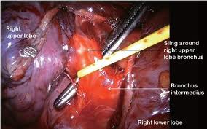
Right upper lobe
Sling around right upper lobe bronchus
Bronchus intermedius
Right lower lobe

Slide 50
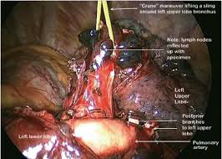
“Crane” maneuver lifting a sling arched left upper lobe bronchus
Hold lymph nodes reflected up with specimen
Left upper lobe
Posterior bronchus to left upper lobe
Pulmonary artery

Slide 52
ATS 2018/ Am J Resp Crit Care

Slide 53
ATS 2019

Slide 54
Early Use Of Awake Video Assisted Thoracic Surgery (AVATS) in Pleural Effusions to Expedite Diagnosis and Treatment
Ara S. Klijian, MD Cardiothoracic Surgery, Sharp & Scripps Healthcare, San Diego, CA
Kaveh Bagheri, MD Pulmonary/Critical Care Sharp Grossmont Hospital, San Diego, CA
Raed Al-Naser, MD Pulmonary/Critical Care Sharp Grossmont Hospital, San Diego =, CA

Slide 55
Methods
Compared 30 primary thoracentesis (25 via image guided IR approach & 5 bedside thoracentesis) with 30 patients who had AVATS as first line approach for diagnosis and treatment.
Demonstrate efficacy and show safety with AVATS as first line treatment.

Slide 56
Discharge Data
29 of the 30 AVATS patients were discharged in under 24 hours from surgery, while 1 patient was discharged on post operative day 2.

Slide 57
SCCM CONGRESS 2022

Slide 59
ATS 2023 San Fran ERAS

Slide 60
Chest 2022 Nashville

Slide 62
AVATS(Awake Video Assisted Thoracic Surgery) vs. Standard VATS: Comparison of Air Leak Rates/Duration
Ara S. Klijian MD 1, Kaveh Bagheri MD 2, Gurvijay Singh MD 3, Serre Klijian
1-Chairman, Cardiothoracic Surgery Sharp Grossmont Hospital. Director, Minimally Invasive Cardiothoracic Surgical Institute of San Diego
2- Medical Director, Burr Heart & Lung Clinic
3-Intensivist/Pulmonologist Sharp Grossmont

Slide 63
DATA
268 VATS 762 AVATS
Air leak < 3 days 22% 2%
PAL(>3d) 6% 0%
Opioids until D/C 68% 1%
Avg CT duration 42 hours 23 hours
LOS 3.2 days 1.2 days

Slide 64
Minimizing air leaks Via AVATS
Dexmedetomidine allowed for arousal of patient at end of case and eliciting cough, while scope still in the chest, directly visualized air leaks allowing for repair with suture/ staples and sealants.
Avoid general anesthesia /intubation eliminated coughing/bucking seen after extubation thus preventing pressure/strain on suture/staple lines.

Slide 65
Conclusions
AVATS is a safe option in select patients, including patients w/ malignancies assuming no evidence of nodal disease on CT/PET or EBUS, resulting in lower LOS, better patient satisfaction, and presumably lower costs.

Slide 66
Not all cases should be done less invasively
“A man has got to know his limitations”
Clint Eastwood in Dirty Harry

Slide 67
Contraindications for AVATS
Central, bulky tumors.
Pancoast Tumors.
Sleeve lobectomy.
Pneumonectomy.
Deep, hilar nodal involvement.
Large chest wall involvement.

Slide 68
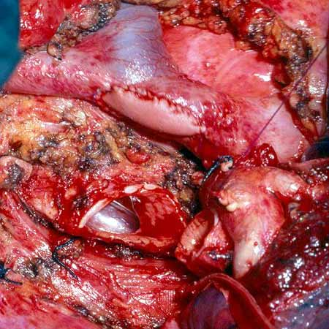
Bulky Tumor

