Slide 1
Diagnosis and Management of ILD
Niranjan Jeganathan, MD, MS, FCCP, ATSF
Associate Professor of Medicine, Division of Pulmonary and Critical Care

Slide 2
Disclosures
None

Slide 3
Objectives
Review the framework for the classification of interstitial lung diseases (ILD)
Highlight the importance of early referral
Review the ILD diagnostic work-up
Review the management of ILD

Slide 4
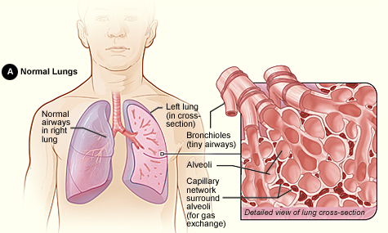
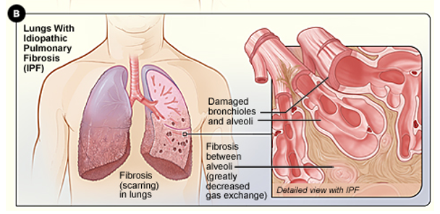
Normal vs. Abnormal Lung “Interstitium”
www.nhlbi.nih.gov

Slide 5
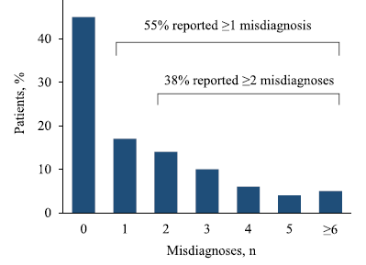
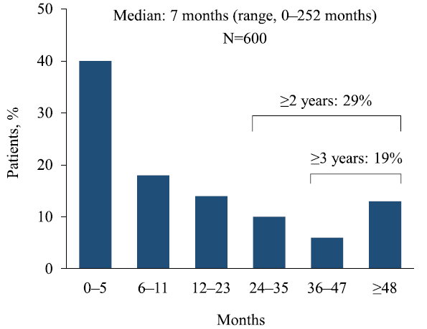
ILD Diagnosis Delay
Cosgrove, GP et al. BMC Pulmonary Medicine, 2018

Slide 6
Case Presentation
76 y.o. Caucasian male presented with dry cough for 5 years, shortness of breath for 2 years
Treated for COPD with inhalers
Smoked 1 PPD for 35+ years (quit in 2018)
SH - Worked as a respiratory therapist
FH - Unremarkable
PE - Crackles at bilateral bases
Labs - ANA 1:1280

Slide 7
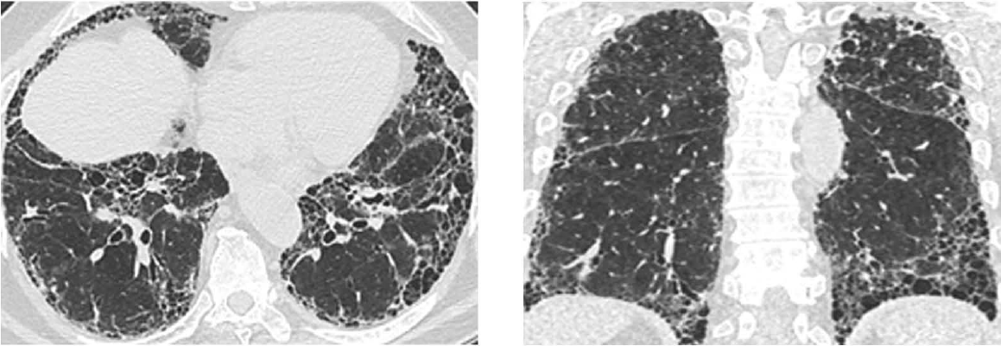
Patient Case - HRCT

Slide 8
Interstitial Lung Diseases
Cottin, V et al. Eur Respir Rev, 2018

Slide 9
ILD Evaluation - History
Rashes, joint pain/swelling, muscle weakness, skin tightening, dysphagia → Connective Tissue Disease-ILD
Environmental history (birds, mold) → Hypersensitivity Pneumonitis
Occupation history (silica, asbestos) →Pneumoconiosis
Family history (CTD, ILD)
Medications (Amiodarone, MTX, nitrofurantoin)
Smoking and other drug use
Early graying, bone marrow abnormality, liver disease → Genetic

Slide 10
ILD Evaluation
Physical Exam:
  Crackles, location
  Autoimmune features
High-resolution CT scan:
  Thin cuts, non-contrast
  Inspiratory +/- expiratory/prone images
Laboratory work-up:
  Autoimmune serologies

Slide 11
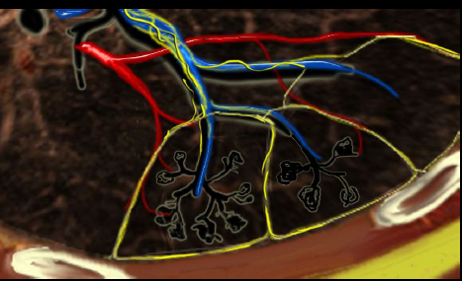
ILD CT Signs
Wallis, A et al. BMJ, 2015

Slide 12
Usual Interstitial Pneumonia (UIP)
Basilar, subpleural
Honeycombing
Traction bronchiectasis/bronchiolectasis
Jeganathan, N et al. Lung, 2020

Slide 13
Idiopathic Pulmonary Fibrosis
More common over the age of 60 years, and in males
Chronic interstitial pneumonia
Cough and dyspnea with exertion
Increased risk – smoking, GERD
“Velcro” crackles, clubbing
If CT is diagnostic (UIP pattern), bx not required

Slide 14
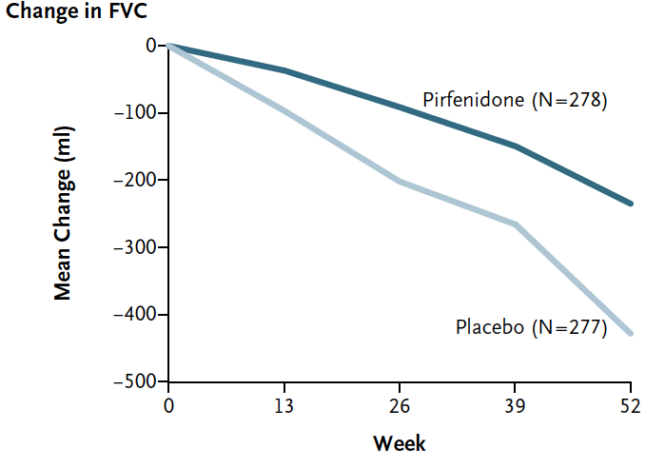
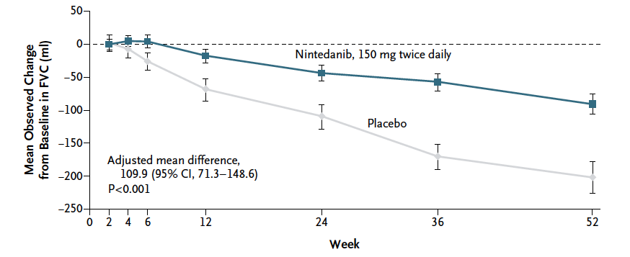
IPF – Treated with Antifibrotics
Pirfenidone
Nintedanib
King, TE et al. NEJM, 2014
Richeldi, LR et al. NEJM, 2014

Slide 15
Prevalence of Autoimmune-ILD
Fischer, A et al. Arthritis & Rheumatology, 2019

Slide 16
Clinical Signs: Scleroderma
Sclerodactyly
Raynaud’s phenomenon
Telengiectasias
Abnormal nailfold capillaries
Digital ulcer
Perelas, A et al. Lancet Resp Med, 2020

Slide 17
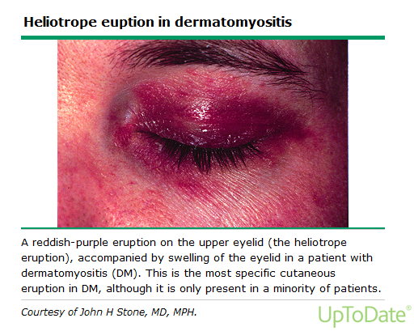
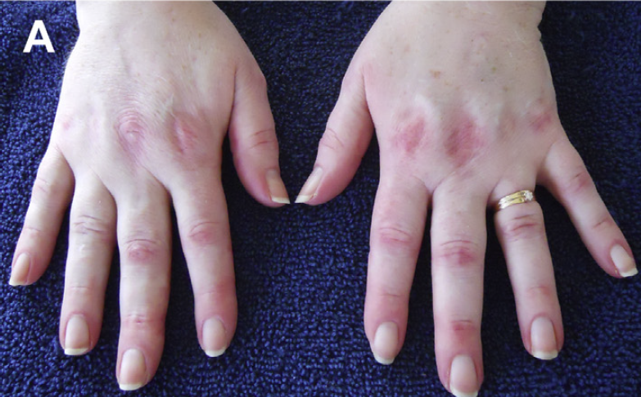
Clinical Signs: Myositis
B
Heliotrope Rash
Gottron Papules
Mechanic Hands
C
Long, K et al. Clin Chest Med, 2019

Slide 18
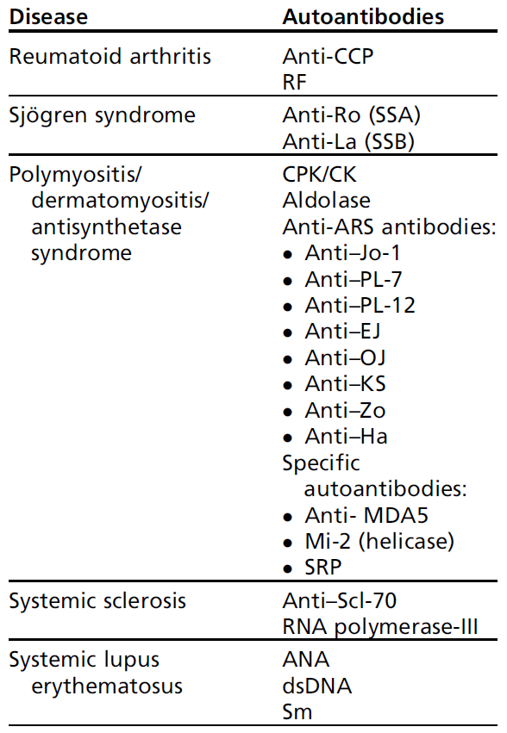
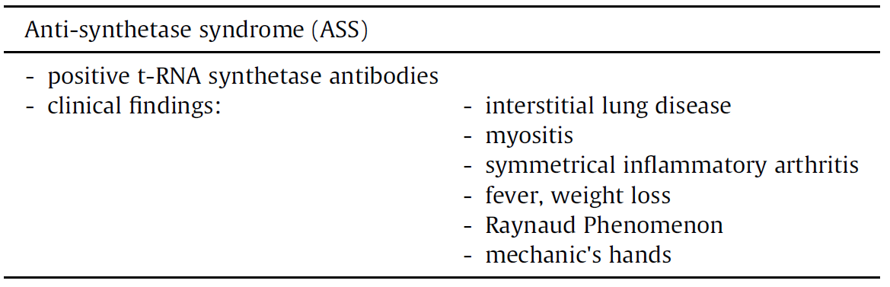
Autoantibodies
Antin-Ozerkis, D et al. Clin Chest Med, 2019
Long, K et al. Clin Chest Med, 2019

Slide 19
Interstitial Pneumonia with Autoimmune Features
Graney, B et al. Ann Am Thorac Soc, 2019

Slide 20
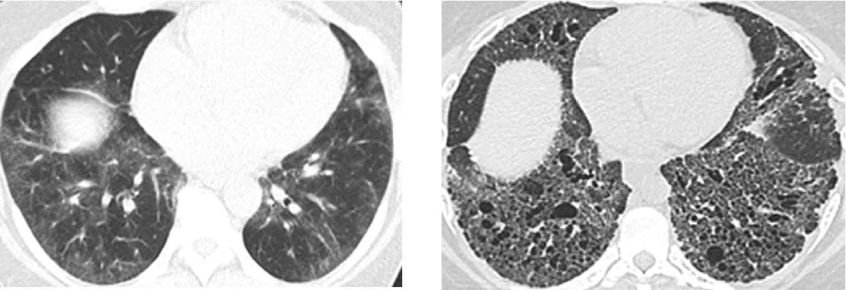
Non-Specific Interstitial Pneumonia (NSIP)
Basilar, symmetric
Ground-glass opacities or Traction bronchiectasis
Subpleural sparing
Jeganathan, N et al. Lung, 2020

Slide 21
Organizing Pneumonia (OP)
Patchy Consolidation
Subpleural or Peribronchovascular
Migratory
Jeganathan, N et al. Lung, 2020

Slide 22
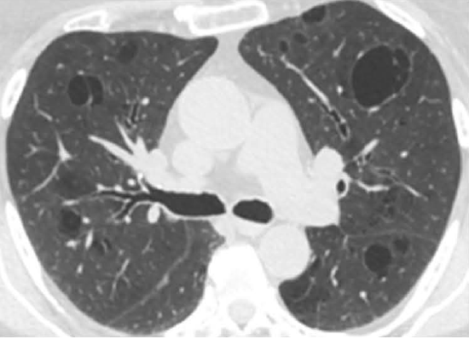
Lymphocytic Interstitial Pneumonia (LIP)
Perivascular
Thin-walled cysts
Surrounding ground-glass
Jeganathan, N et al. Lung, 2020

Slide 23
Prevalence of Histological Patterns with CTD
Wells, AU et al. Nat. Rev. Rheumatol 2014

Slide 24
CTD-ILD Pharmacological Treatment
Corticosteroids
Cyclophosphamide (SLS 1 study, NEJM 2006)
Mycophenolate (SLS 2 study, Lancet 2016)
Rituximab
Tocilizumab (focuSSed study, Lancet 2020)
Nintedanib (SENSCIS study, NEJM 2019)

Slide 25
Mycophenolate vs. Cyclophosphamide for SSc-ILD
RCT, multicenter
MMF1500mg BID for 24 months vs. oral CYC 2mg/kg per day for 12 months
Primary end-point: % FVC change at 24 months
142 patients randomized
  Scleroderma symptoms < 7 years
  Ground glass opacity on HRCT
Tashkin, DP et al. Lancet, 2016

Slide 26
Mycophenolate in CTD-ILD
Fischer, A et al. J Rheumatol, 2013

Slide 27
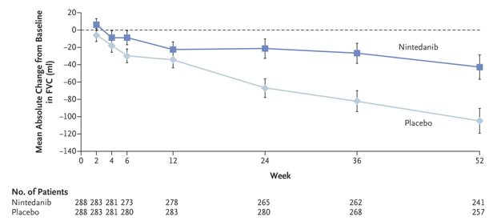
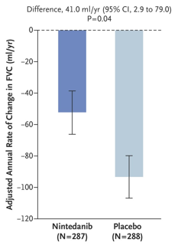
Nintedanib for SSc-ILD
RCT, multicenter
Nintedanib 150mg BID vs. Placebo
Primary end-point: FVC decline in 52 weeks
576 patients randomized
  Onset of SSc symptoms < 7 years
  HRCT fibrosis ≥ 10% of lungs
Disler, O et al. NEJM, 2019

Slide 28
Tocilizumab in Systemic Sclerosis
Interleukin-6 receptor inhibitor
RCT, Multicenter
Tocilizumab 162mg SC weekly vs. placebo (48 wks)
Secondary outcome: FVC % predicted at 48 weeks
210 patients randomized
  Progressive diffuse SSc
  ≤ 5 years
Khanna, D. et al. Lancet, 2020

Slide 29
Prognosis Varies by Type of ILD
Oldham, J et al. Eur Respir J, 2016

Slide 30
Other Pulmonary Manifestations
Wells, AU et al. Nat. Rev. Rheumatol 2014

Slide 31
Hypersensitivity Pneumonitis
Hypersensitivity pneumonitis (HP) is an inflammatory and/or fibrotic disease affecting the lung parenchyma and small airways that results from an immune mediated reaction provoked by an overt or occult inhaled antigen in susceptible individuals
Raghu, G et al. Am J Respir Crit Care Med, 2020

Slide 32
Hypersensitivity Pneumonitis - CT Patterns
Centrilobular Nodules
Mosaic Attenuation (inspiratory scan)
Air-trapping (expiratory scan)
Raghu, G et al. Am J Respir Crit Care Med, 2020

Slide 33
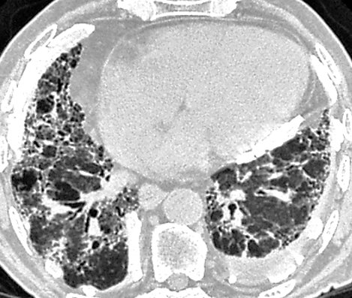
Asbestos- Related Lung Diseases
Benign pleural effusions
Pleural plaques
Pleural fibrosis
Asbestosis
Bronchogenic carcinoma
Mesothelioma
Pulmonary fibrosis,
calcified pleural plaques
“Comet tail sign”
pleural-based mass (round atelectasis) with extensions toward the hilum
Pulmonary Boards Review, ATS 2015

Slide 34
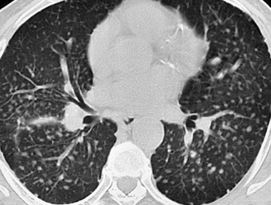
Pneumoconiosis
Silicosis
  Sandblasting, masonry, glass manufacturing
  10-30 years after exposure
  Simple silicosis (upper lung nodules), progressive massive
  fibrosis
Coal workers
  Coal mining
  Simple nodules, progressive massive fibrosis, Caplan nodule
Beryllium
  Aerospace, electronics
  Similar to sarcoidosis (parenchymal nodules, lymphadenopathy), noncaseating granulomas
  Beryllium lymphocyte proliferation test
Centrilobular and perilymphatic nodules from simple silicosis
Pulmonary Boards Review, ATS 2015

Slide 35
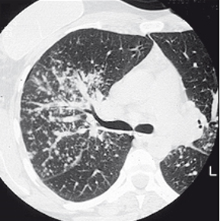
Sarcoidosis
<40 years, African Americans, Sweden, Denmark
Labs: hypercalcemia/calciuria, BAL lymphocytosis, CD4/CD8 >3.5
Dx: TBNA, Tbbx (not for Lofgren sx, lupus pernio, Heerfordt sx and +/- BL lymphadenopathy)
Treatment:
  Spontaneous remission common with Stage I and II
  Prednisone, methotrexate, anti-TNF (refractory)
Nodules (bronchovascular bundle and pleura)
Non-caseating granulomas
Pulmonary Boards Review, ATS 2015
Notes:
fever, night sweats, fatigue, and weight loss
Endobronchial disease in 40%
Hypercalcemia occurs in 1–4% of cases, and hypercalciuria occurs in 15–40%.
BAL shows lymphocytosis in > 80% of patients
Heerfordt syndrome is a rare manifestation of sarcoidosis. The symptoms include inflammation of the eye (uveitis), swelling of the parotid gland, chronic fever, and in some cases, palsy of the facial nerves.
Berylliosis Affects patients working with circuit boards/electronics. Similar findings on x-ray. Diagnosis made with lymph transfer test on bronchoalveolar lavage

Slide 36
Cottin, V et al. Eur Respir Rev, 2018

Slide 37
Multi-Disciplinary Discussion
“Gold Standard”
“The process of achieving a multidisciplinary diagnosis in a patient with IIP is dynamic, requiring close communication between clinician, radiologist, and when appropriate, pathologist. Clinical data (presentation, exposures, smoking status, associated diseases, lung function, laboratory findings) and radiologic findings are essential for multidisciplinary diagnosis.”
Travis, WD et al. Am J Respir Crit Care Med, 2013
Notes:
Gold standard in diagnosis of ILD is no longer histopathology but a Multidisciplinary discussion involving the clinician, radiologist, rheumatologist and when appropriate pathologist.

Slide 38
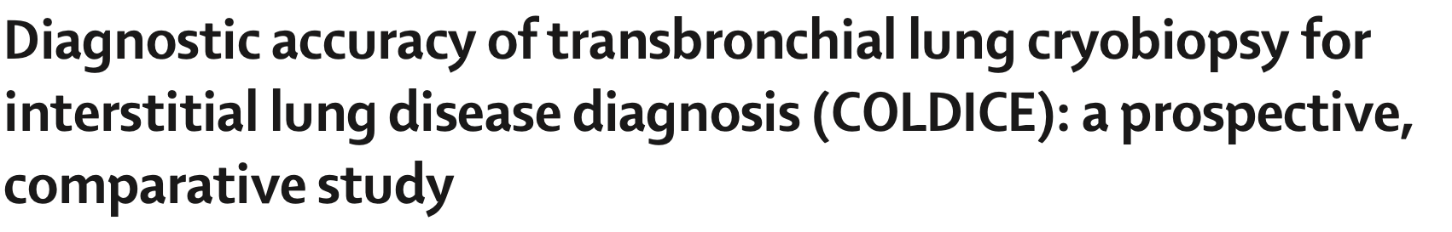
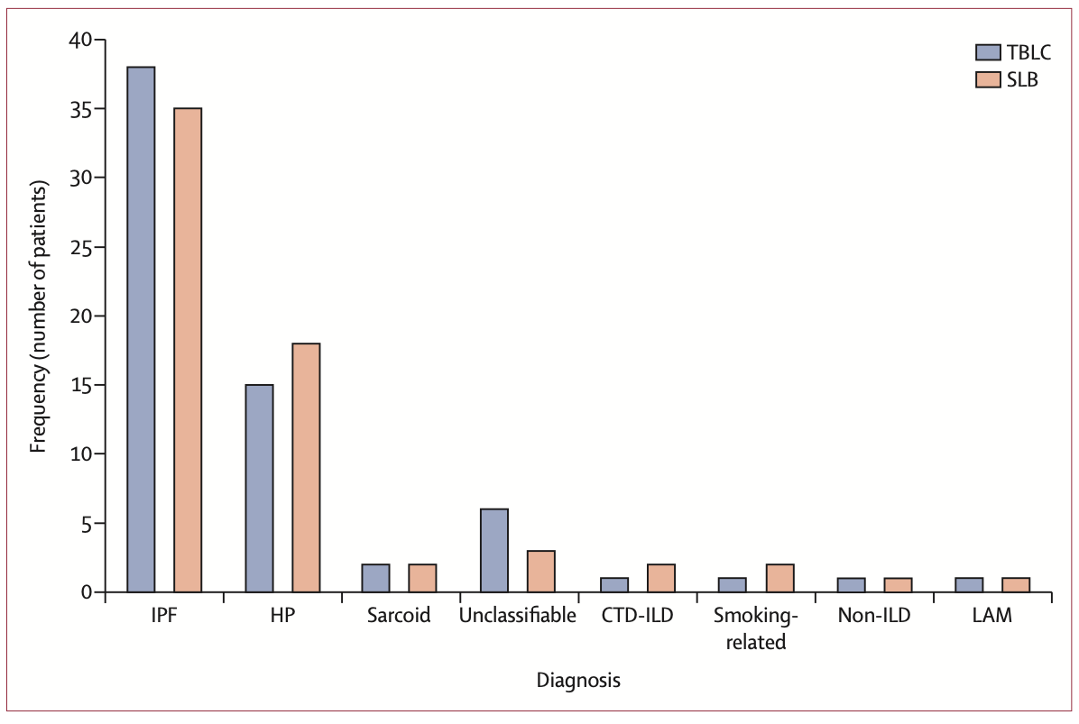
Troy LK et al. Lancet, 2020
Notes:
For biopsy another option to surgical biopsy is cryobiopsy where with a bronchoscope a piece of lung tissue is obtained using a cryoprobe. The biopsy pieces could be up to about 1 cm in size compared to 2-3mm with transbronchial and could be sufficient to obtain a diagnosis. As shown in this study the diagnostic rate was comparable to surgical biopsies.

Slide 39
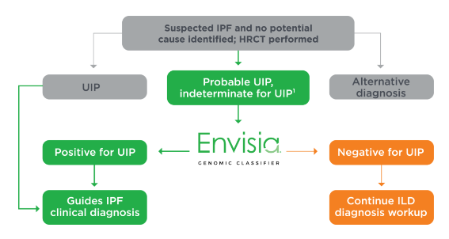
Genomic UIP testing by transbronchial biopsy
https://lung.veracyte.com/envisia

Slide 40
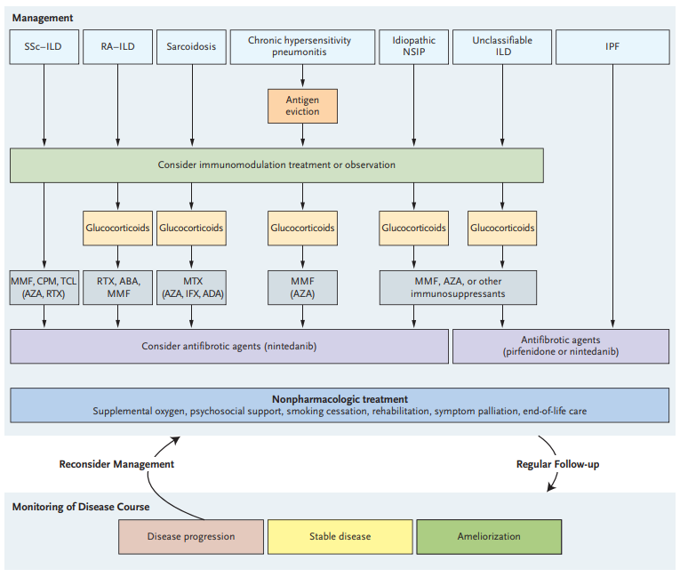
Wijsenbeek, M et al. NEJM, 2020

Slide 41
Summary
ILD is a broad category with numerous subtypes
Early recognition and referral to an ILD center is important
Diagnosis and treatment involves a multidisciplinary team
Pharmacotherapy involves targeting inflammatory and/or fibrotic pathways
Non-pharmacological therapies include supplemental oxygen, pulmonary rehab and symptom management

Slide 42

Thank you for your time and attention
Niranjan Jeganathan MD, MS, FCCP, ATSF
Associate Professor of Medicine
Director, Interstitial Lung Disease Program
Loma Linda University Health
Loma Linda, CA

Slide 43
Questions & Answers

