Slide 1
Junctional Hemorrhage
Paul Wisniewski, do

Slide 2
What are we talking about?
Junctional hemorrhage: bleeding from the areas at the junction of the trunk and its appendages
This is a difficult problem in trauma.
These areas are not amenable to regular tourniquets as they cannot fit to give circumferential pressure around the extremity.

Slide 3
The Areas in Question

Slide 4
What works well?
Tourniquets on extremities control hemorrhage and stop bleeding very effectively
So much so that it has reduced mortality in the combat theater
Vietnam 9 % of deaths were from exsanguinating extremity wounds
Somalia 7% of deaths were from exsanguinating extremity wounds
Currently 2% of deaths were from exsanguinating extremity wounds
Note Israeli forces are the most aggressive with tourniquet placement and they sight a 0% mortality from limb exsanguination
Source: The Journal of Emergency Medicine, Vol. xx, No. x, pp. xxx, 2009. BATTLE CASUALTY SURVIVAL WITH EMERGENCY TOURNIQUET USE TO STOP LIMB BLEEDING John F. Kragh, Jr, COL, MC, USA,* Michelle L. Littrel, CPT, AN, USA,† John A. Jones,* Thomas J. Walters, PHD,* David G. Baer, PHD,* Charles E. Wade, PHD,* and John B. Holcomb, MD

Slide 5
Tourniquets on extremities

Slide 6
CLASSIFICATION OF JUNCTIONAL TRAUMA:
TYPE 1
Wound encroaches on a junctional zone but surgical control can be gained without entering adjacent body cavity.
Proximal control requires surgical incision extending across the joint flexure.
Source: EXTREMITY, JUNCTIONAL, AND PELVIC TRAUMA RICHARD REED, FRCA*; PAUL MOOR, BMedSci (Hons), FRCA†; and VICTORIA PRIBUL, FRCA

Slide 7
CLASSIFICATION OF JUNCTIONAL TRAUMA:
TYPE 2
Wound encroaches on a junctional zone requiring surgical access to gain hemorrhage control.
Body cavity may need to be entered, eg, laparotomy/thoracotomy.
Potential for occult blood loss.
EXTREMITY, JUNCTIONAL, AND PELVIC TRAUMA RICHARD REED, FRCA*; PAUL MOOR, BMedSci (Hons), FRCA†; and VICTORIA PRIBUL, FRCA

Slide 8
what can be done to temporize bleeding in the “field” to get patients to definitive care?

Slide 9
Abdominal Aortic Junctional Tourniquet
(AAJT)
It has 510(k) clearance from the FDA for difficult to control inguinal and pelvic hemorrhage
It can be applied to the mid-abdomen, tightened and inflated and may remain on for up to an hour safely.
It is also FDA cleared for all junctional hemorrhage sites (axilla and inguinal placements) and can remain on for up to 4 hours in these locations.
Source: https://www.chinookmed.com/05246/abdominal-aortic-junctional-tourniquet-aajt.html

Slide 10
Aajt instructions for use
WAIST - WINDLASS – WEDGE
Buckle device around patient’s waist
Position bladder over umbilicus (belly button)
Tighten belt
Tighten and secure windlass
Inflate bladder (wedge) until green indicator shows

Slide 11
Steps1-3: Position at umbilicus and tighten the belt around patient

Slide 12
Step 4: Tighten the Windlass

Slide 13
Step 5: Inflate the center balloon

Slide 14
Inflating the Bladder
Continue to squeeze the 5 oz. hand bulb until the pressure gauge shows green
GREEN: 250-300 mm Hg
RED: > 300 mg Hg
Notes:
100% of the human subjects had full occlusion at just under 250 mm Hg.
The inflation system incorporates a bleed-off design to limit pressures under 300 mm Hg. The bench testing on bladder failure show that pressures over 1034 mm Hg can result in RF weld leaking or rupture. Inflation until the pressure indicator reveals a green strip indicates that the pressure in the bladder has reached 250 mm Hg. At 230 mm Hg, 100% of the human subjects had full occlusion of the flow in the femoral arteries.
If the device is inflated to pressures over 300 mm Hg the internal bleed-off mechanism in the gauge will allow enough air to escape to prevent sustained pressures greater than 300.

Slide 15
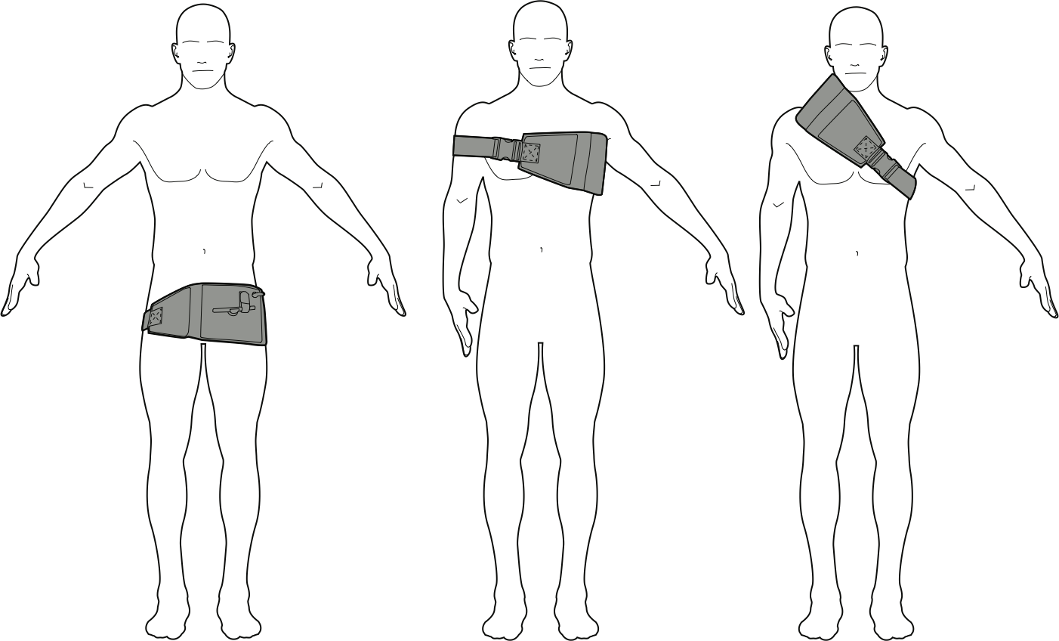
New Application Sites
THERE ARE THREE NEW SITES OF APPLICATION FOR THE AAJT:
THE GROIN, THE AXILLA, AND THE NECK.
Notes:
There are three new sites of application for the AAT. The Groin, the axilla and the neck. These sites will be shown in detail in the slides to follow.

Slide 16
SAMS Tourniquets
The Target Compression Device (TCD) is placed at or near the injury site and pumped up until the bleeding stops.
Two TCDs can be used to occlude blood flow bilaterally if needed.
Source: https://www.chinookmed.com/05248/sam-junctional-tourniquet.html

Slide 17
SAMS Tourniquets

Slide 18
SAMS Tourniquets

Slide 19
SAMS Tourniquets

Slide 20
Target Compression Device (TCD)
Pressure Relief Valve (PRV) – 17 PSI
Burst Pressure ~70 PSI
Inflates to 3.2” high
Body of TCD is made of Texin – material also used in protective eyewear, golf ball and whitewater raft protective coating products
Base of TCD is Makrolon polycarbonate material, which is also used in bullet-proof glass and combat helmet products
Body and base are welded, not glued

Slide 22
Tourniquet placed at the sight of hemorrhage

Slide 23
XSTAT-12

Slide 24
Syringe filled with sponges that expand to fill wound

Slide 25
How to use xstat-12
Step one:
Place Syringe in Wound

Slide 26
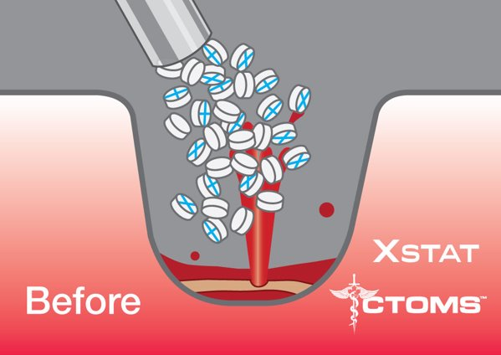
How to use xstat-12
STEP 2:
INJECT SPONGES

Slide 27
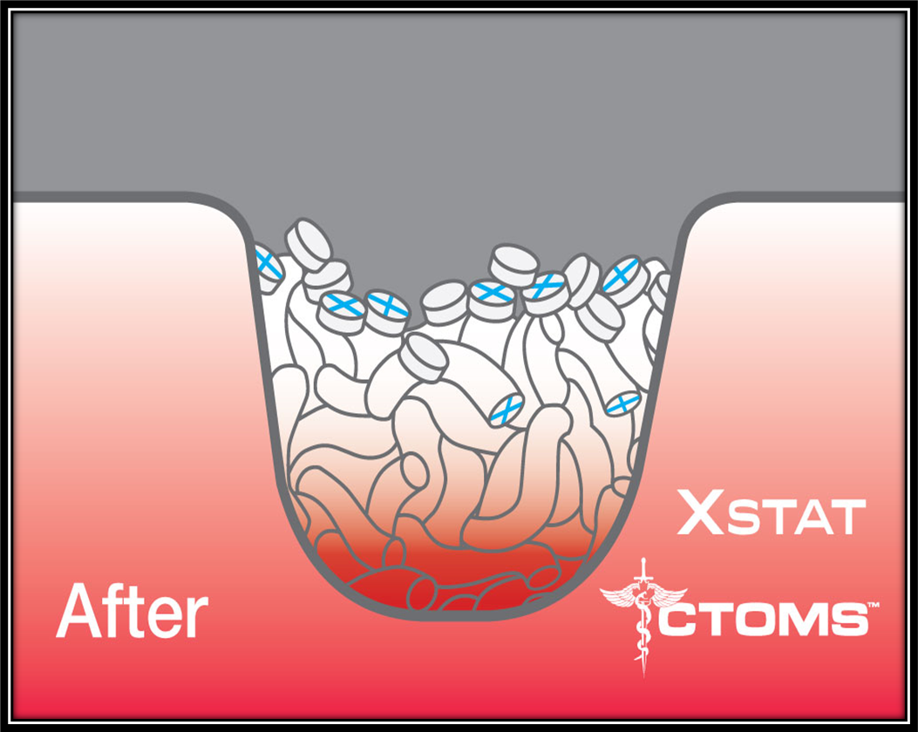
How to use xstat-12
STEP 3:
SPONGES EXPAND TO TAMPONADE BLEEDING

Slide 28
Two Sizes: XSTAT-12 and XSTAT- 30
SOURCE: https://www.revmedx.com/xstat/

Slide 29
Combat Ready Clamp (CROC)

Slide 30
FDA-Approved CRoC Application Points
The Combat Ready Clamp is indicated for use on the battlefield to control difficult bleeds in the inguinal area.
(FDA approved indication)
Note: The CRoC should NOT be applied above the inguinal ligament.
There are two modes of use for the CRoC:
Direct pressure: Use directly on the site of external hemorrhage for bleeding sites below the inguinal ligament
Proximal Pressure: Use at or just below the inguinal ligament to compress the external iliac/femoral artery
Notes:
The CRoC is not approved by the FDA at this time for application higher in the abdomen, in the axillary region, or at the neck.
30

Slide 31
Croc example in the field

Slide 32
When all else Fails?
Use Surgical Exposure and control

Slide 33
Surgical Exposure of the Axillary Artery

Slide 34
Axillary Artery Exposure

Slide 35
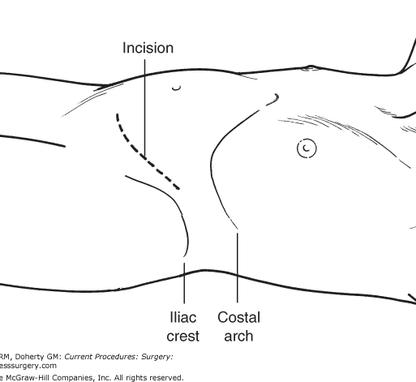
Surgical exposure of the Iliac artery

Slide 37
What about REBOA??

Slide 38
ZONE 1 REBOA

Slide 39
Summary
Junctional Hemorrhage is a difficult problem to manage in the civilian and military settings.
There are multiple new devices commercially available; no one device has proven itself superior at this time.
Surgical exposure and control is the only tested and definite treatment for these injuries.
REBOA may be of some use for iliac hemorrhage but could potentially make axillary hemorrhage worse.

